Slide 1

TYPES OF FUEL CELL
1 | Alkaline FC (AFC)
2 | Proton Exchange Membrane FC (PEMFC)
3 | Phosphoric Acid FC (PAFC)
4 | Molten Carbonate FC (MCFC)
5 | Solid Oxide FC (SOFC)
6 | Direct Methanol Fuel Cell (DMFC)

Slide 2
Types of Fuel Cells
Fuel Cell Type
Temp of Operation [ºC]
Unit Sizes [kW_{e}]
Most likely applications
Alkaline Fuel Cell (AFC)
RT – 100
< 100
Space , Military recently terrestrial applications
Proton Exchange Membrane Fuel Cell (PEMFC)
RT – 100
0.1 - 100
Portable devices like Lap Tops, Cellular phones, Video Cameras etc
Domestic & Dedicated Power (+ heat)
Buses, Passenger Cars, Service Vehicles, Railway Locomotives & Streetcars etc
Phosphoric Acid Fuel Cell
(PAFC)
100 – 210
5 - 200
(also MW sized plants)
Dedicated Power (+ heat),
Railways
Molten Carbonate Fuel Cell
(MCFC)
650
100 - 2,000
(plants up to 100 MW)
Dispersed Power & Utility Power (Combined Cycle -with downstream Steam Turbine)
Solid Oxide Fuel Cell
(SOFC)
800-1000
2.5 – 250
(plants up to 100 MW)
Domestic & Commercial (heat and power), Utility Power (combined cycle)
Mobile applications for railways

Slide 3
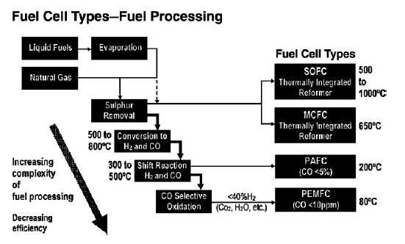
Types of Fuel Cells
SOFC

Slide 4

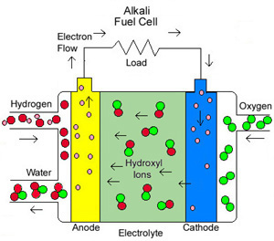
1. ALKALINE FUEL CELL
compressed hydrogen and oxygen fuel
potassium hydroxide (KOH) electrolyte
~70% efficiency
150˚C - 200˚C operating temp.
300W to 5kW out put requires pure hydrogen fuel and platinum catylist → ($$)

Slide 5
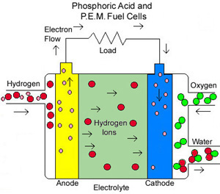
2.PROTON EXCHANGE
MEMBRANE FUEL CELL
thin permeable polymer sheet electrolyte
40 – 50% efficiency
50 – 250 kW
80˚C operating temperature
platinum catalyst on both sides of membrane electrolyte will not leak or crack
temperature good for home or vehicle use

Slide 6
3.PHOSPHORIC ACID FUEL CELL
phosphoric acid electrolyte
40 – 80% efficiency
150˚C - 200˚C operating temp
11 MW units have been tested
sulphur free gasoline can be used as a fuel
The electrolyte is very corrosive
Platinum catalyst is very expensive

Slide 7
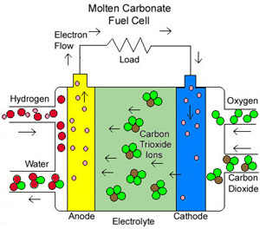
4.MOLTEN CARBONATE FUEL CELL
carbonate salt electrolyte
60 – 80% efficiency
~650˚C operating temp.
cheap nickel electrode catylist
up to 2 MW constructed, up to 100 MW designs exist
operating temperature is too hot for many applications

Slide 8
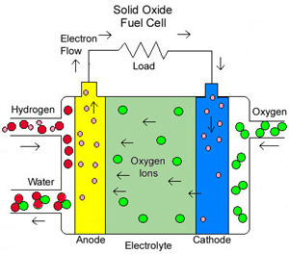
5.SOLID OXIDE FUEL CELL
high temp / catalyst can extract the hydrogen from the fuel at the electrode
SOFC units are very large
solid electrolyte cells output up to 100 kW hard ceramic oxide electrolyte
~60% efficient
~1000˚C operating temperature

Slide 9

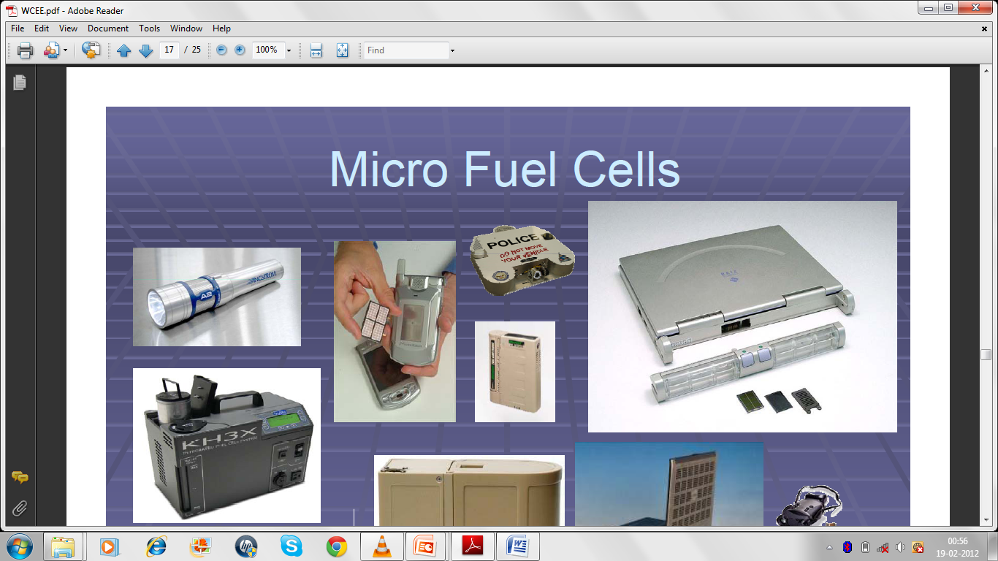
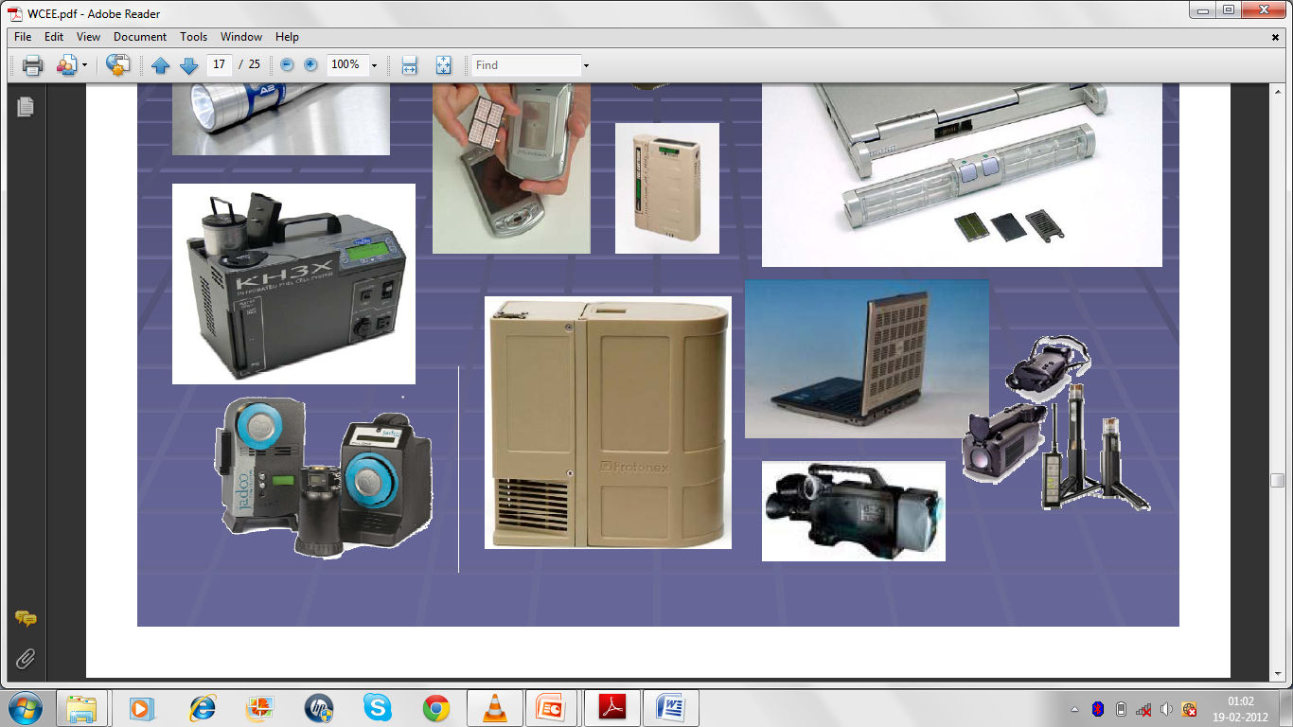




MICRO FUEL CELLS

Slide 10
Uses of fuel cells
in NASA space programs to generate power for probes, satellites and space capsules
They are also used to power fuel-cell vehicles, including forklifts, automobiles, buses, airplanes, boats, motorcycles and submarines

Slide 11
MICRO/PORTABLE FUEL CELL APPLICATIONS
Consumer electronics: Cell phones, PDAs, laptops, music players
First Responder: 2-way radios, communications centers
Defense (soldier power): Communications, computing, sensors, UAVs
Industrial & Specialty applications: Battery charging stations
Handheld data terminals
Inventory/warehouse management
Satellite Phones, surveillance

Slide 12
Benefits
Efficient: in theory and in practice
Portable: modular units
Reliable: few moving parts to wear out or break
Fuel Flexible: With a fuel reformer, fuels such as natural gas, ethanol, methanol, propane, gasoline, diesel, landfill gas,wastewater, treatment digester gas, or even ammonia can be used
Environmental: produces heat and water (less than combustion in both cases)
near zero emission of CO and NO_{x}
reduced emission of CO₂ (zero emission if pure H₂ fuel)

Slide 13

  ADVANTAGES AND
  DISADVANTAGES OF FUEL CELLS
  ADVANTAGES
  Efficiency is very high approximately 90%
  Pure Water is the only discharge
  Simple and safe
  No moving parts
  Noise less, compact size
  Long life span
  Quick start
  No pollutions
  Odor less

Slide 14
  DISADVANTAGES
  Cost is very high
  CO₂ discharged with methanol reform
  Little more efficient than alternatives
  Technology currently expensive
    Many design issues still in progress
  Hydrogen often created using “dirty” energy (e.g., coal)
  Pure hydrogen is difficult to handle
    Refilling stations, storage tanks, …

